Slide 1


Titolo presentazione sottotitolo
Autonomous Weapons should not be outlawed
Milano, XX mese 20XX
Computer Ethics 2020/2021
Professor Viola Schiaffonati
Daniele Comi
26 November 2020

Slide 2
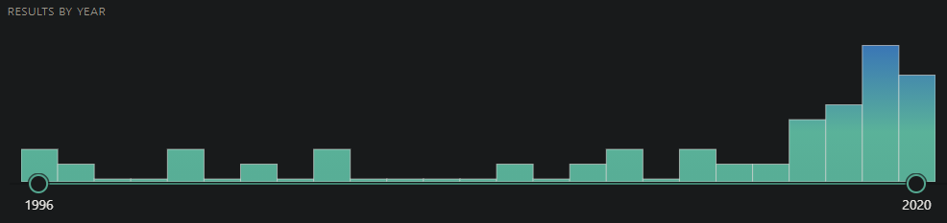
Introduction
Different points of view from researchers and nations at UN
Still no accepted conclusion has been reached
Lots of debates and research on this topic, also increasing
Source: pubmed.ncbi.nlm.nih.gov

Slide 3
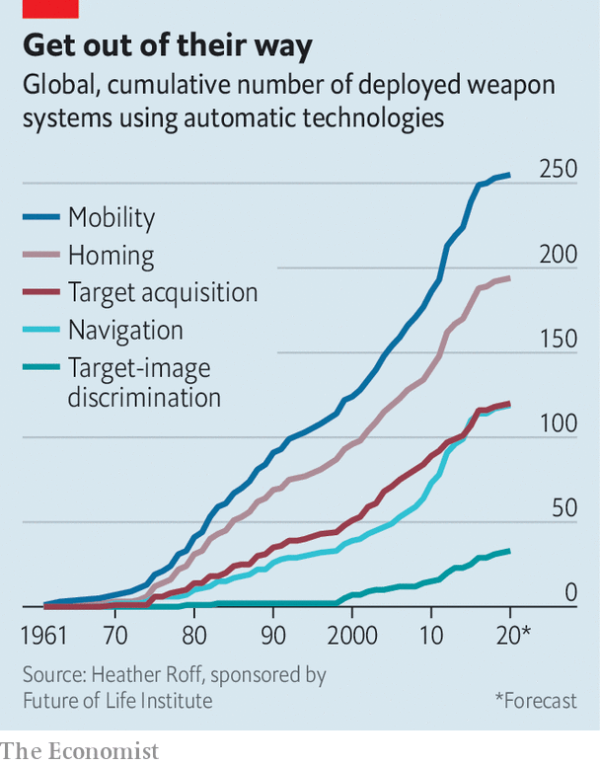
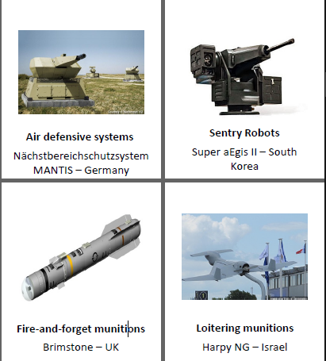
Some background first
Autonomous Weapons Systems (AWS):
A weapons system able to select and engage targets without any human intervention after its activation [1]
Classification of already existing AWS:
Air Defence Systems
Active Protection Systems
Robotic Sentries
Guided Munitions
Loitering Munitions
And new to come…

Slide 4
Some background first
Two main point of views which started the debate [1]
Ronald C. Arkin: «Robots not only can be better than soldiers in conducting warfare in certain circumstances, but they also can be more humane in the battlefield than humans»
Noel Sharkey: «Rather than making war more humane and ethical, autonomous armed robotic machines are simply a step too far in the dehumanization of warfare. We must continue to ensure that humans make the moral decisions and maintain direct control of lethal force»

Slide 5
The importance of AWS
Autonomous Weapons Systems will be foundamental in the future:
geopolitical stability
defense
Progress can’t be stopped
It’s really important we focus on the regulation, study and control of AWS instead of thinking of banning AWS out of existence, which WON’T SOLVE THE PROBLEM

Slide 6
AWS are not to be banned
Main arguments for this thesis
Reducing human injuries and casualties
Studying counterattacks and defences against AWS
Parallelism to the mutual assured distruction of Nuclear Weapons
Enormous misconception around AI creating fear of AWS
Main counterarguments adressed
Accountability
Lethal action from AWS versus human life
Increment of conflicts

Slide 7
Reducing human injuries and casualties
Employing AWS will drastically reduce the amount of human injuries and casualties, both military and civilians
States will be able to reduce the amount of man-power present in military actions, so:
More precise, fast and reliable-over-time actors [4]
Less humans involved in actions involging harm or lethal risks
Capability of solving extreme situations: a killed-in-action AWS is not a killed-in-action human

Slide 8
Mutual Assured Distruction
Autonomous Weapons Systems create a mutual vulnerability: the weaponization of AI will create deterrence and will maintain a strategic stability, meaning a more effective defense
It pushes states to think twice before employing an AWS, creating a mutual assured distruction, like for Nuclear Weapons, as well as for AWS. This is because “the purpose is not destruction, but gaining a political benefit by making the costs of offense very high and intolerable” [2]
Nations, and state leaders, are driven by security-seeking interests not by destruction interests!

Slide 9
Mutual Assured Distruction
Charateristic | AWS | Nuclear Weapons
Scale of destruction | Destructive | Highly destructive
Proportion of punishment | Severe | Severe
Interests | Security-seeking | Security-seeking
Parity/Disparity | War is highly unlikely | War is highly unlikely
Command and Control | Reliable | Reliable
Strike Capability | Second strike | Second strike
Possibility of disruption | Likely | Highly unlikely
Perception of threats | High | High
Offense Defense | Defense | Defense
Deterrence | Successful | Successful
Owned by | TBD | States ONLY and NATO
Law | Still in debate | Highly regulated
Keep these in mind!
Useful
«new»
charat-
eristics!
Most of charateristics taken from [2]

Slide 10
Accountability
Accountability must be discussed in any ethical discussion
Here we must address who is held responsible when something bad happens, which means:
Misuse of AWS
Malfunction of AWS
When an autonomous weapon system is used recklessly or with the intention of committing a war crime, International Criminal Law is appropriate: states should be held accountable
They are already, as for Nuclear Weapons, in posses of AWS [3]
So, they should be made exclusively the ones regulating and in possess of AWS

Slide 11
Accountability
It is more likely and normatively preferable to hold states [3]
Why? [3]
States can ensure that AWS are designed and employed accordingly to the IHL
States are already held responsible for the development, purchase and integration of AWS in their military forces
States are capable of any kind of compensations, even to other states
The last two points will encourage states to regulate and act as a more effective deterrent to overuse than individual liability

Slide 12
Accountability
The laws regarding states accountability already exists! [3]
States will be likely to accept the fact that “when something goes wrong” they will be held accountable:
Compensation payouts already exists
States are less prone to admit fault than to accept a disciplination regarding moral blame [3]
Which means that they will be more prone for a legislation accounting them for misuse or malfunction of AWS

Slide 13
Ethics on AWS pursuing lethal actions
This important aspect can be solved by introducing the concept of moral agency enactor
Human operative who takes part in decision process of life and death actions performed by an AWS
This Moral Agency Enactor is described under the Meaningful Human Control (MHC) [1]

Slide 14
Meaningful Human Control
Meaningful Human Control: a more constrained AWS which helps solving some of its ethical problems by introducing an human mediator
MHC is a method to create more cohesion between humans and AWS when taking decisions and it is divided in two types of policies:
Uniform Policies (more inflexible)
Differentiated Policies (more precise)

Slide 15
Increment of conflicts
Some say that the usage of AWS would encourage furthermore wars and conflicts because a state wouldn’t loose any human life, having so congress and people support
But there is always an adequate process of selection of the best weapon to use, both for attacks and for responses
AWS would not make the decision to go to war easy [4]
Like no one would respond right away with nuclear weapons

Slide 16
Increment of conflicts
Combined with the previous argument regarding the Mutual Assured Distruction, this is a sound argumentation
Exploiting augmentation by analogy of Nuclear Weapons, the critical question «will the conflicts around the world increase?» is answered negatively
The conclusion that the conflicts around the world given the presence of AWS will not increase is plausible!
AWS is not the cause of conflicts, humans are
Conflicts are not, unfortunaltely, something new!

Slide 17
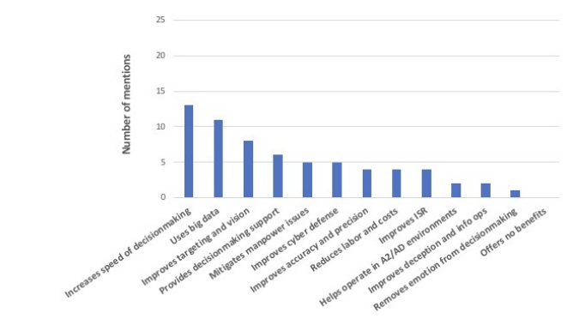
Conclusions
Benefits of AWS can be shortly summed up here [4]

Slide 18
Conclusions
Some helpful hints which can be stated for a better AWS regulations and usage are the following [3]:
Drafting Multilateral Agreements for AWS regulation
Using the MHC approach on AWS to help creating a trade-off on human interaction
Drafting a Nuclear Weapons-like NATO legislation for AWS
Letting nations draft Nuclear Weapons-like legislations for state-only possess and usage of AWS
Promoting AWS control rather than banning/non proliferating it
We could be in a pivot point in time, where future is shaped: let’s make the most of it!

Slide 19
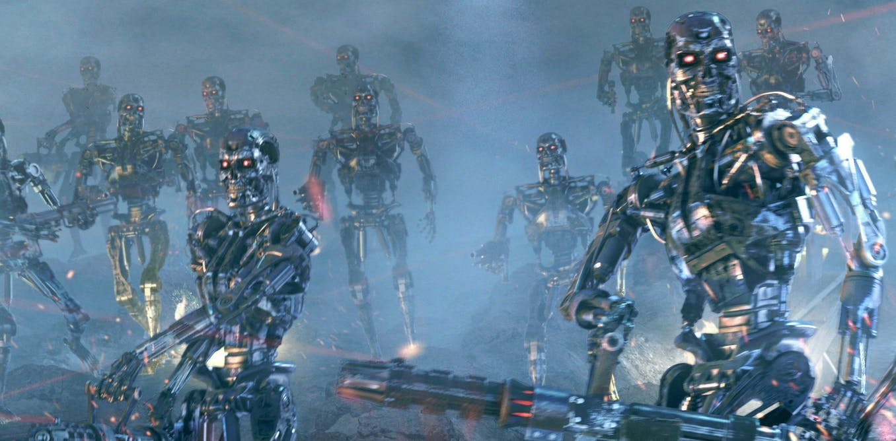
So, will we come to this?
NO!
Obviously…

Slide 20
References
Daniele Amoroso, Guglielmo Tamburrini (2020). ”Autonomous Weapons Systems and Meaningful Human Control: Ethical and Legal Issues”, Current Robotics Reports (e-ISSN 2662-4087), 4-8.
Gilan Osama Kamal Mahmoud Mohamed Dahab (2018). ”The weaponization of artificial intelligence (AI) and its implications on the security dilemma between states: could it create a situation similar to "mutually assur mutually assured destruction ed destruction" (MAD)?”, The American University in Cairo - School of Global Affairs and Public Policy, 31, 40, 45-59.
Rebecca Crootof (2016). ”War Torts: Accountability for Autonomous Weapons”, University of Pennsylvania Law Review (Vol. 164, No.6), 1389-1393.
Forrest E. Morgan, Benjamin Boudreaux, Andrew J. Lohn, Mark Ashby, Christian Curriden, Kelly Klima, Derek Grossman (2020). ”Military Applications of Artificial Intelligence: Ethical Concerns in an Uncertain World”, RAND Corporation (ISBN: 978-1-9774-0492-3), 15-22.

Slide 21
Thank you
Any question?

